Slide 1

Office Rental Service
Capstone Project Defense
Supervisor: Mr. Nguyễn Trọng Tài
Members : Lê Xuân Tiến
Nguyễn Vũ Hoàng Quốc
Trương Tiến Thành
Trần Lê Tuấn

Slide 2
Contents
Current Situation
Solution
Business Model
Revenue Model
System Component
Project Features
Search Office - Request Appointment - Create Contract
Request Office
Request Rental/Repair
Extend and Return contract
Statistic and Management
Pros and Cons
Future Development
Notes:
Chia lại luồng search – appointment, accept – contract - extend contract, Repair request,

Slide 3
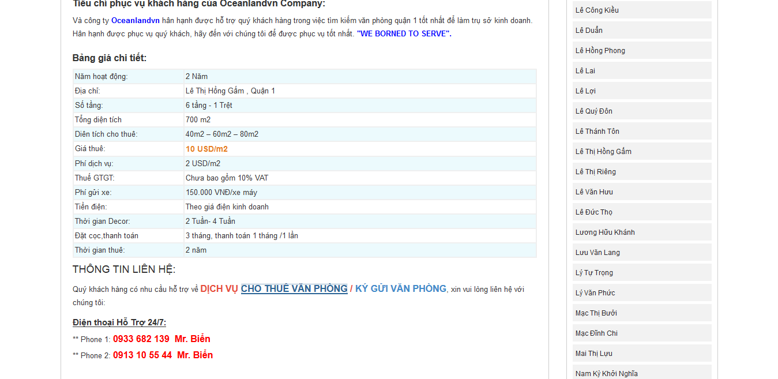
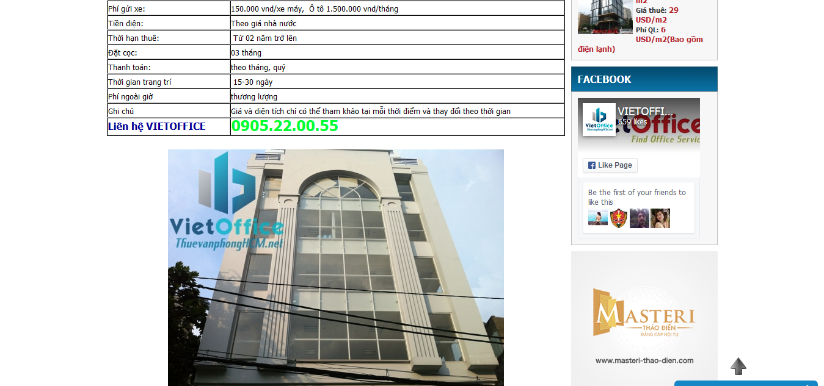
Current Situation
Only provide information of offices.
Customers contact with owners directly.
Owners hardly to sign the contract.
http://vanphonggiatotchothue.com
http://www.vanphongchothuequan1.com.vn
Notes:
customer service: appointment, rental and repair service

Slide 4







Business Model
Supplier
Office Rental Service System
Customer
Contact with
Manager
Staff
Owners
Manage
Belong to
Customer
System
Offices
Notes:
customer service: appointment, rental and repair service

Slide 5


Revenue Model Based on commission
Supplier
Office Rental Service System
Customer
Give
Rent
Owners
Price
Contract
Customer
Commission
Manager

Slide 6
Revenue Model Based on price difference
Supplier
Office Rental Service System
Customer
Give
Base price
Owners
Rent
Price
Contract
Customer
Give
Manager

Slide 7
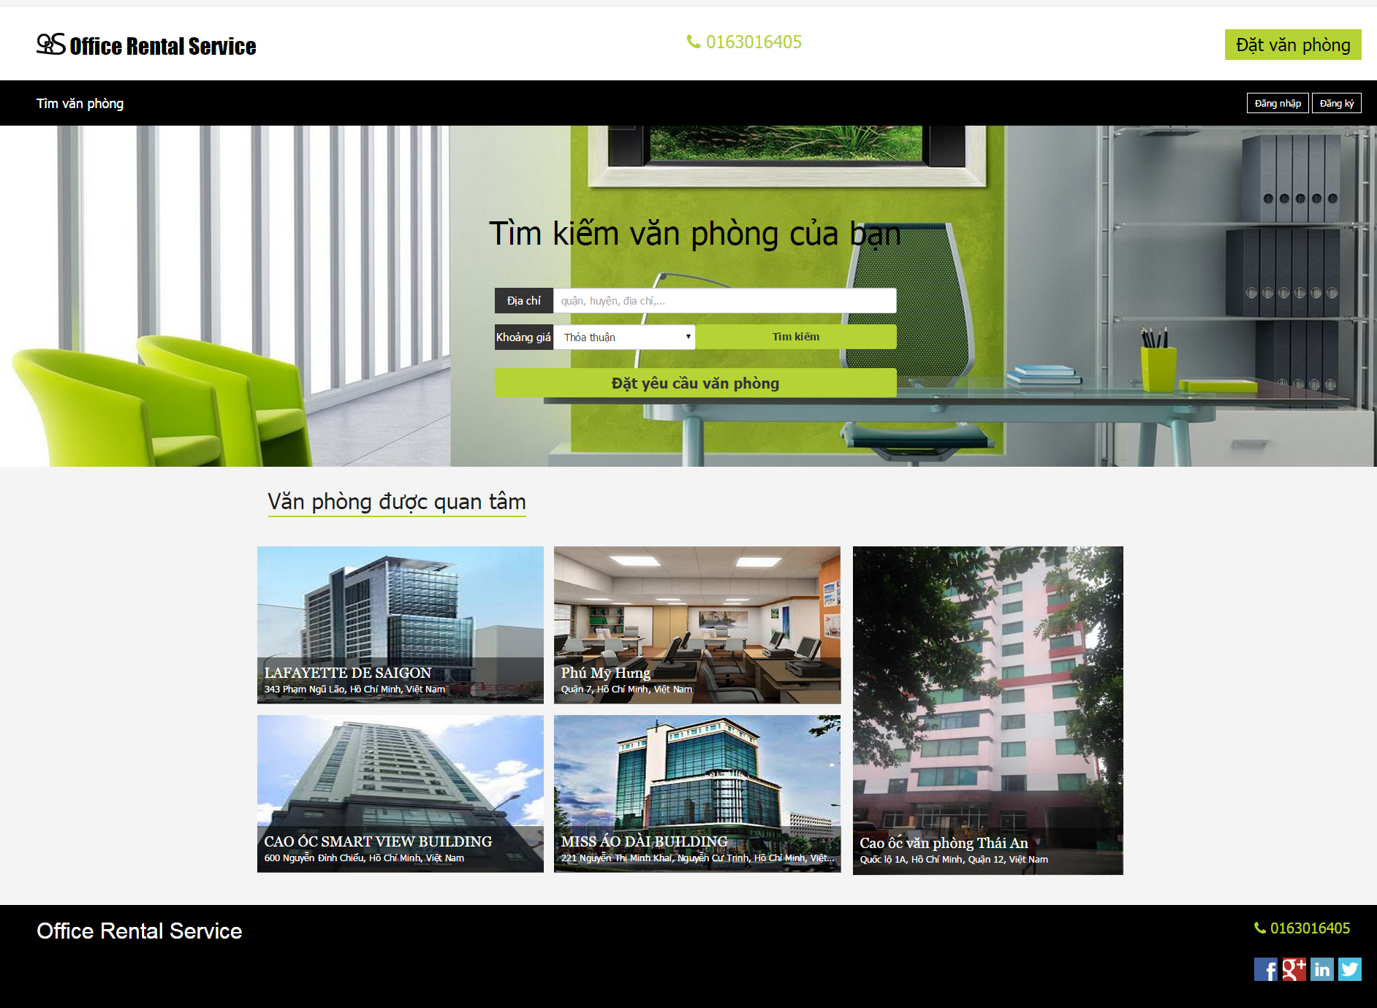
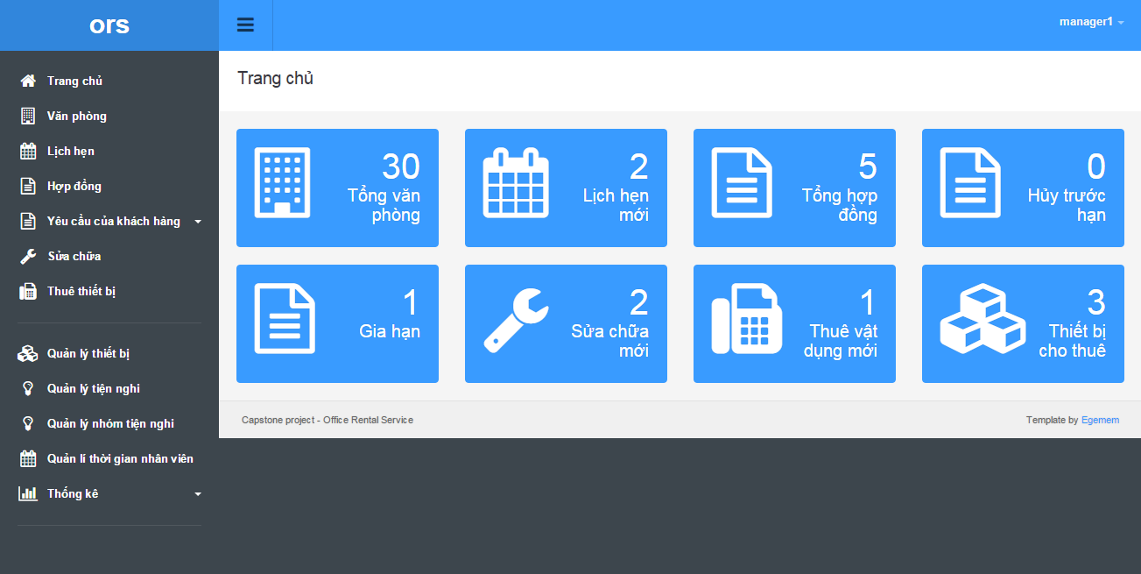

System component
Manage office
Office Rental Service System
Search office
Manage appointment
Request appointment
Manager
Staff
Customer
Schedule request
Request office
Create contract
Manage contract
Customer service
Back office service
Manage repair/ rental
Request repair/ rental
Staff
Mobile
Check assigned request
Check appointment

Slide 8
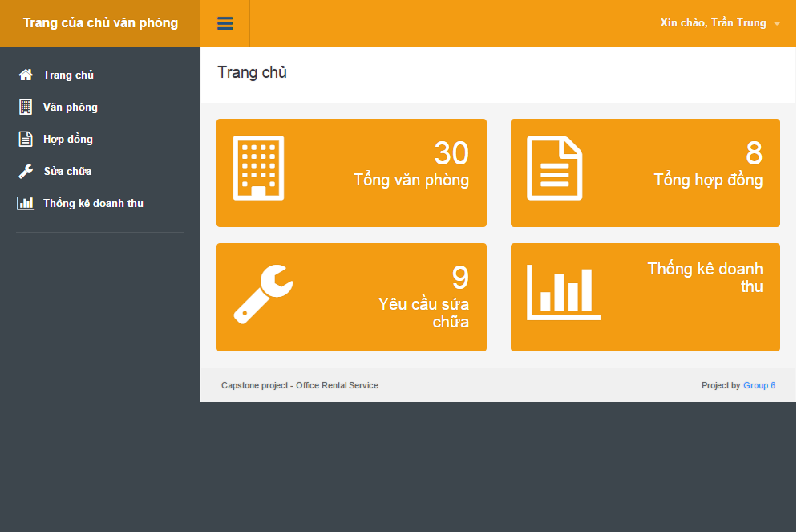
Office Rental Service System
Search office
Manage appointment
Request appointment
Manager
Staff
Customer
Schedule request
Request office
Create contract
Manage contract
Customer service
Back office service
Manage repair/ rental
Request repair/ rental
Owner
Manage office
Staff
Check appointment
Mobile
Check request repair
Owner service
Check assigned request
View Statistic

Slide 9

Project Features Search Office - Request Appointment - Create Contract
Office Rental Service
1
Choose an
office
Create appointment
2
7
Manager
Customer
Check appointment
3
Decide create contract
6
System
Create Contract
Assign
to staff
8
4
Contract
Meet and check office
5
Staff

Slide 10


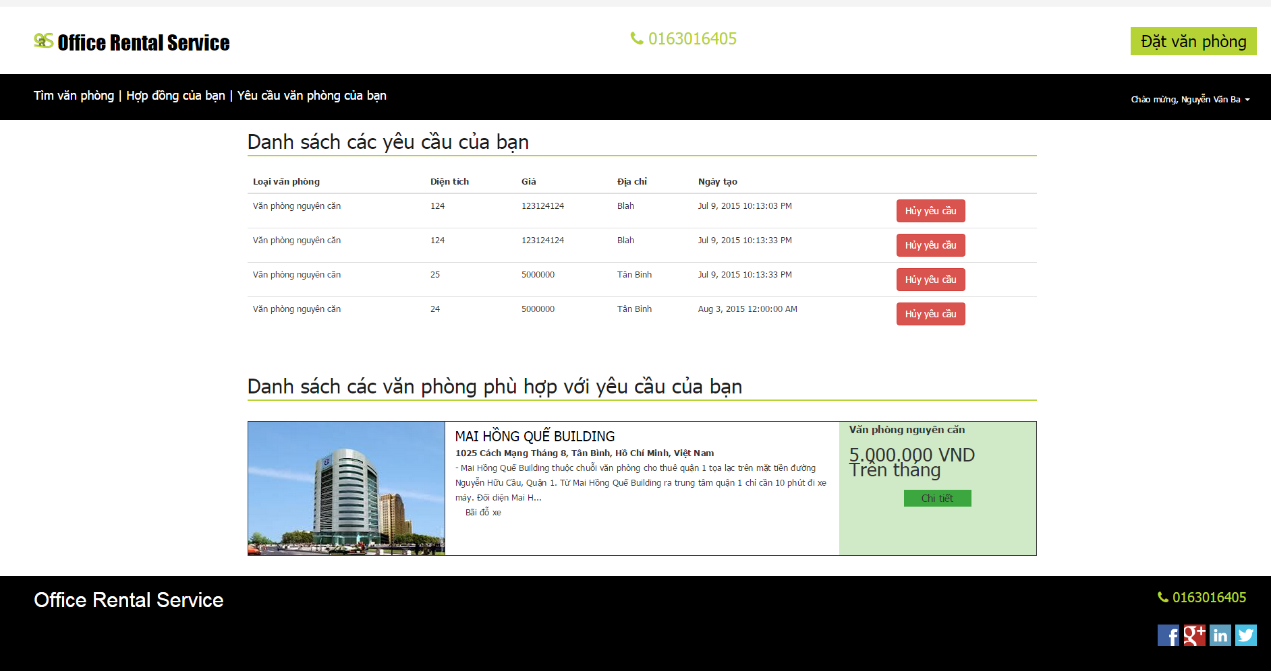
Project Features Request Office
Office Rental Service
Schedule check
2
Send email
4
Email
Belong to
Return data
System
3
Database
Create request
1
5
Check request
Customer
Result page

Slide 11
Project Features Request Rental/Repair
Office Rental Service
Send SMS
Check request
4
2
Send request
Manager
1
Customer
System
Assign
Accept/Reject
3
7
Accept/Reject
5
Meet customer
6
Staff
Notes:
Kính chào quý hđ, tiếp theo tôi xin trình bày chức năng yêu cầu sửa chữa hoặc thuê thêm thiết bị.
quay lai voi ong nguyen van ba, trong luc su dung vp, vi mot ly do nao do, ong muon sua chua thiet bi. de dap ung nhu cau nay, he thong se cho phép ông gửi yêu cầu sửa chữa rồi sau đó tiến hành giải quyết yêu cầu sửa chữa do.
tôi xin phép được demo chức năng chức gửi và xử ký yêu cầu sửa chữa

Slide 12
Project Features Extend/Return contract
Office Rental Service
Send request
1
Check, then
Accept or
cancel request
2
Customer
Manager
System

Slide 13




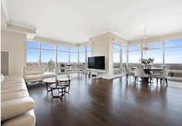

Project Features Management
Request
Appointment
Rental
Manager
Contract
Statistic
Rental item
Amenity

Slide 14
Project Features Management
Admin
User

Slide 15
Pros and Cons
Pros:
Providing search engines criteria: price, location, amenities...
Making an appointment easily.
Manage contract easily.
The customer’s requests are automatically suggest by system.
Helping staff easily to manage and update their jobs by mobile application.

Slide 16
Pros and Cons
Cons:
Owner of the office must contact us to post their information.
The function of notification system is limited.
Only in Ho Chi Minh city.

Slide 17
Future Development
Mobile application for customer.
Owner can create and manage their office.
Extend system for different locations.
Notes:
Về hướng phát triển trong tương lai thì hệ thống sẽ cung cấp ứng…
Chúng tôi đã trình bày xong nội dung đề tài, cảm ơn quý hội đồng, quý thầy cô và các bạn đã theo dõi. Sau đây là phần hỏi đáp và góp ý từ phía hội đồng.

Slide 18
Q&A

Slide 19
K-Means Algorithm

Slide 20
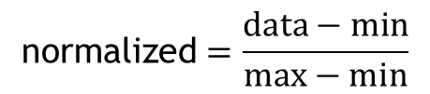
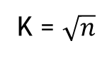
K-Means Algorithm
Start
K = $\sqrt{n}$
Calculate K
$$\text{normalized}=\frac{data−min}{max−min}$$
Normalize data
Group data in K groups

Slide 21
K-Means Algorithm
Start
Calculate K
Normalize data
Group data in K groups
Yes
Group changed?
Calculate the mean of each group
Group based on minimum distance to mean
No
End

Slide 22
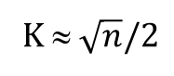
KNN Algorithm
Start
Calculate K
K ≈ $\sqrt{n}/2$
Normalize query point
Calculate min K distance from query point to sample points
More than 1 most frequency
Yes
Return min distance group
No
End

Slide 23
Suggest Schedule
Start
Init schedule
Unassigned job
Suggest assign day (?)
Available staff in assign day?
No
Yes
Suggest assign to staff which have least jobs
Yes
Still have unassigned job
Update schedule
No
End

Slide 24
Thanks for your listening

